Slide 1
User
API Gateway
API Server
API
Global Data Controller
PSelector
Operator Table
Web
Platform Table
Shell
Scheduler
Event Bus
Log
Developer
Executor
Web
Image Repository
Log
Flink
Pytorch
Spark

Slide 2


SELECT * FROM t1 JOIN t2
$$relu(e^{x}+e^{y})$$
$$relu(e^{x}+e^{y})$$
project
relu
relu
join
scan
add
exp
add
exp
scan
exp
exp
CPU: 2.3 GHz
bandwidth: 9.77 gbs
CPU: 2.3 GHz
bandwidth: 9.77 gbs
CPU: 4.0 GHz
bandwidth: 200 gbs

Slide 3
Bandwidth
GPU Memory
Selectivity
SELECT
CPU freq.
Data Size
JOIN
COS
SIN
SSD
JOIN
1
…
JOIN
1
…
SELECT
…
SELECT
…
…
…
COS
COS
…
1
SIN
SIN
…
1
Embedding
Hardware
Workload
One-Hot
Hardware
Workload

Slide 4
Embedding Dictionary
sort:
map:
max:
…
join:
filter:
max
CBOW
sort
map
filter
…
join

Slide 5




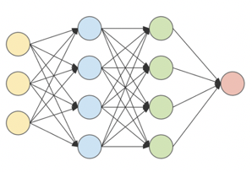
𝑓(x)
slide
Spark
Hadoop
PyTorch
…
…
0
1
Hadoop
Embedding
mask
…
0
Hardware
retrieve
…
Workload
…
…
…
Vectorization
Normalization
Convolution
Classification

Slide 6
0.4
calculate
0.6
locate
0.5
0.8
0.05
source
0.15
save
0.5
1
sample

